Slide 1

Database Explorations
September 29, 2025

Slide 2
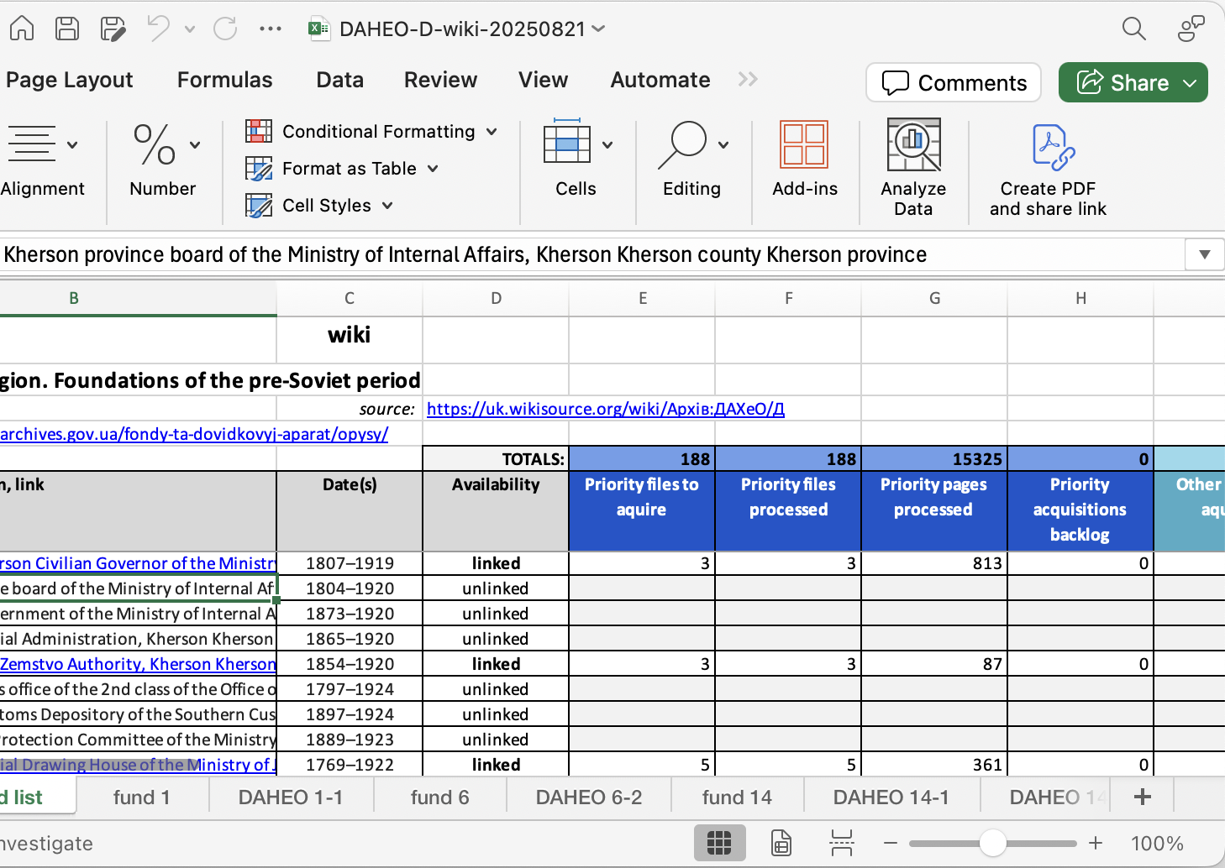
The Problem
With Google Docs,
View and Data are not separated
Labor intensive to maintain
Fragile multi-tab relationship structure
Not amenable to multi-person access
Hard to revise sheet structure
Hard to scale

Slide 3

The Solution
Replace Google Docs with a Database that
Separates data from view
Is easy to maintain and evolve
Can scale
Is built for concurrent access by many users
Replaces multi-tab spreadsheets with extensible, role-specific views
Replaces cross-sheet process reporting formulas with flexible and updatable data roll-ups and scripting
Provides built-in back-up, journaling of data changes, and commenting
Down the road, facilitates AI-assisted triage, etc.

Slide 4
Database Requirements
Low cost (for non-profit org)
Multi-user, with varying access/rights based on role
Easy for anyone to come up to speed (low learning curve)
Easy to create different views for different roles/workflows
Able to sit between Birddog and Google spreadsheets
Easily grow and transform as the system evolves
No lock-in: possible to migrate out down the road

Slide 5
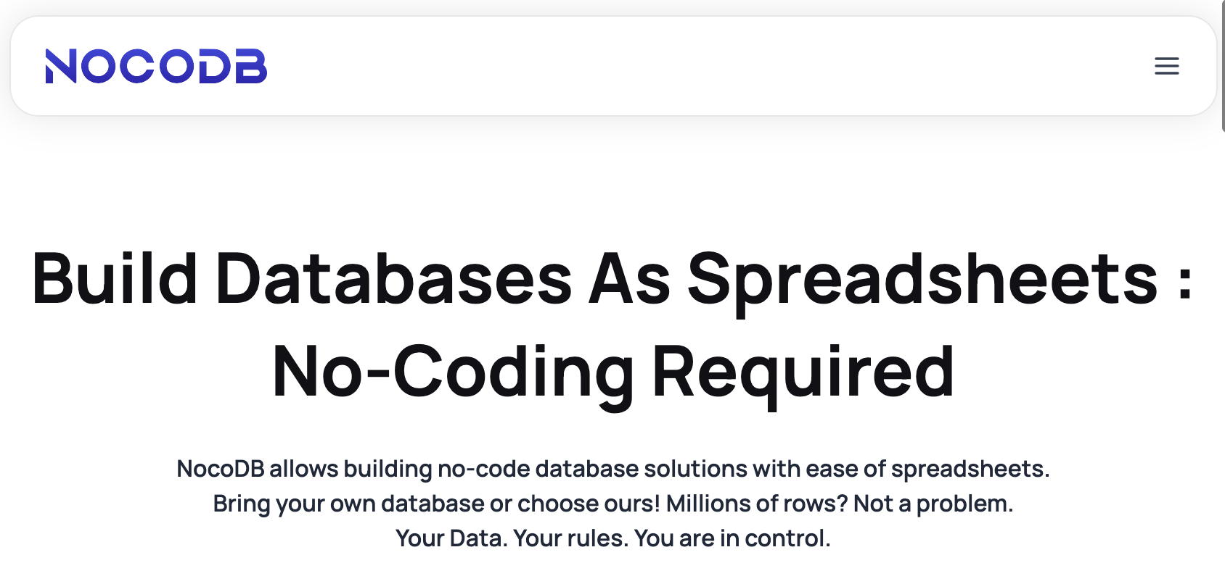
Candidate Database Platform: NocoDB
Low cost
Easy to learn (like AirTable)
Opensource
Open database
Available as hosted solution
Can be self-hosted too
https://nocodb.com/

Slide 6
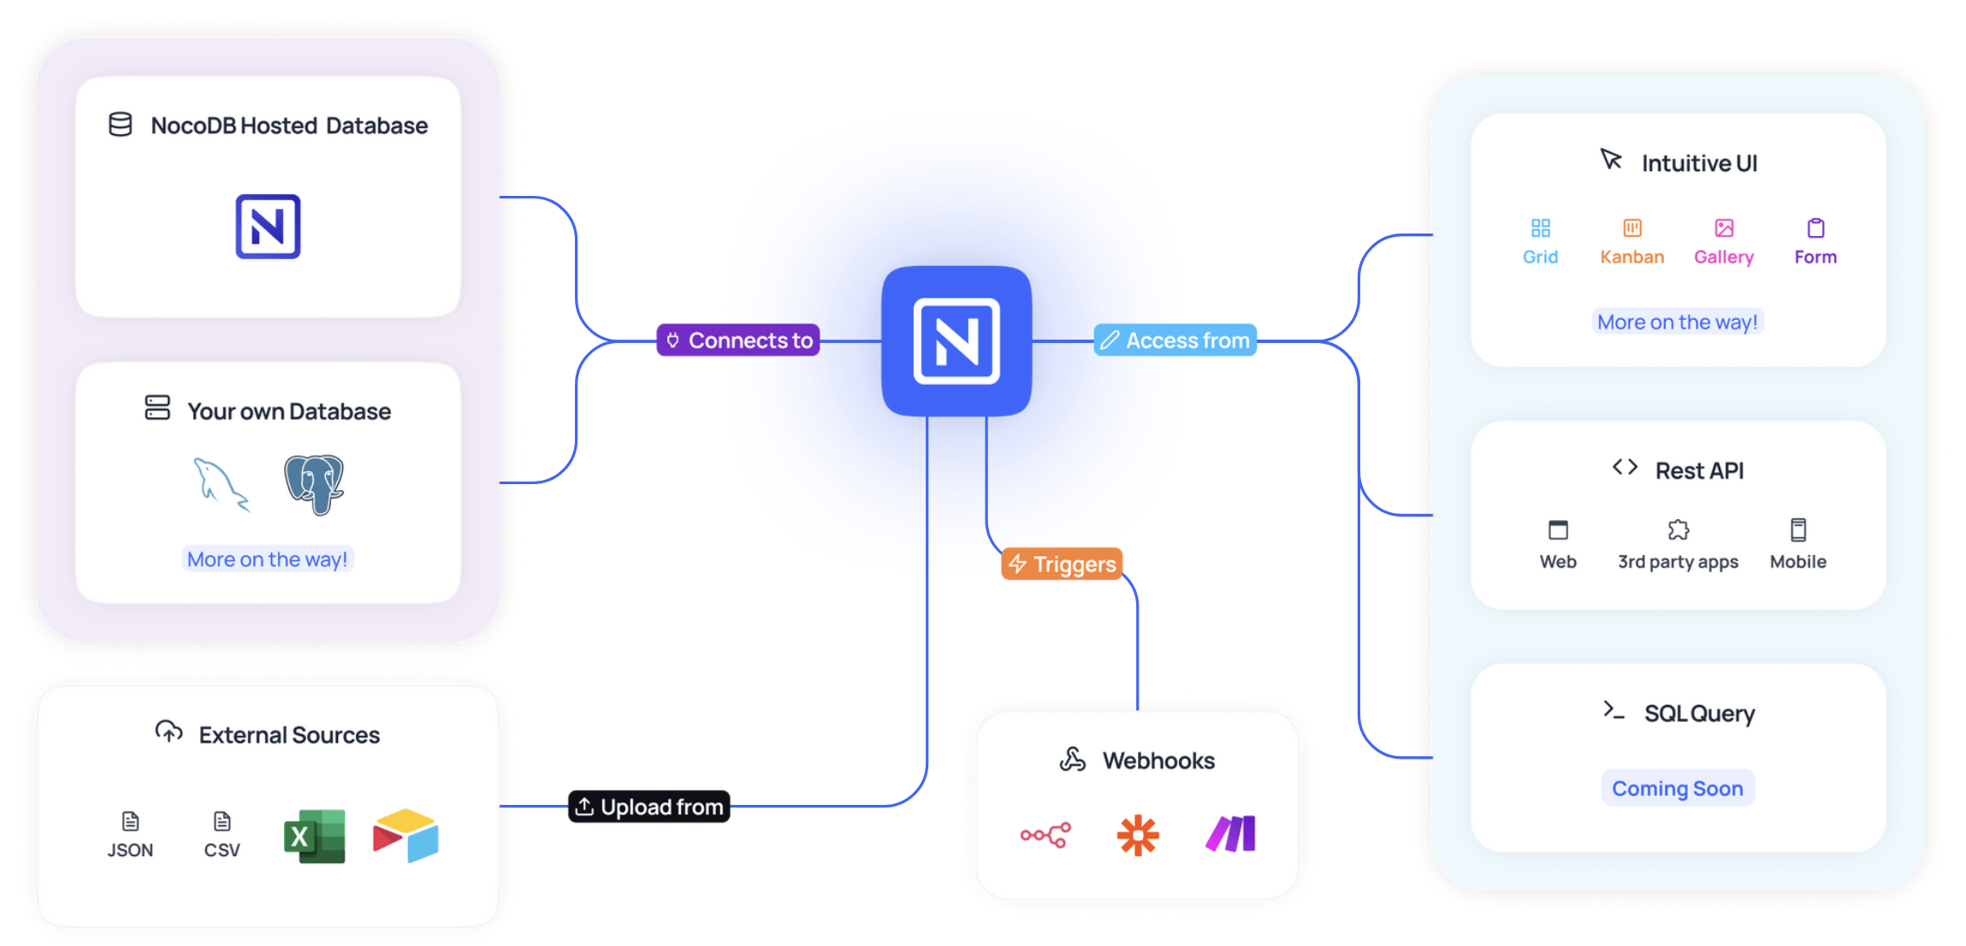
NocoDB Features

Slide 7
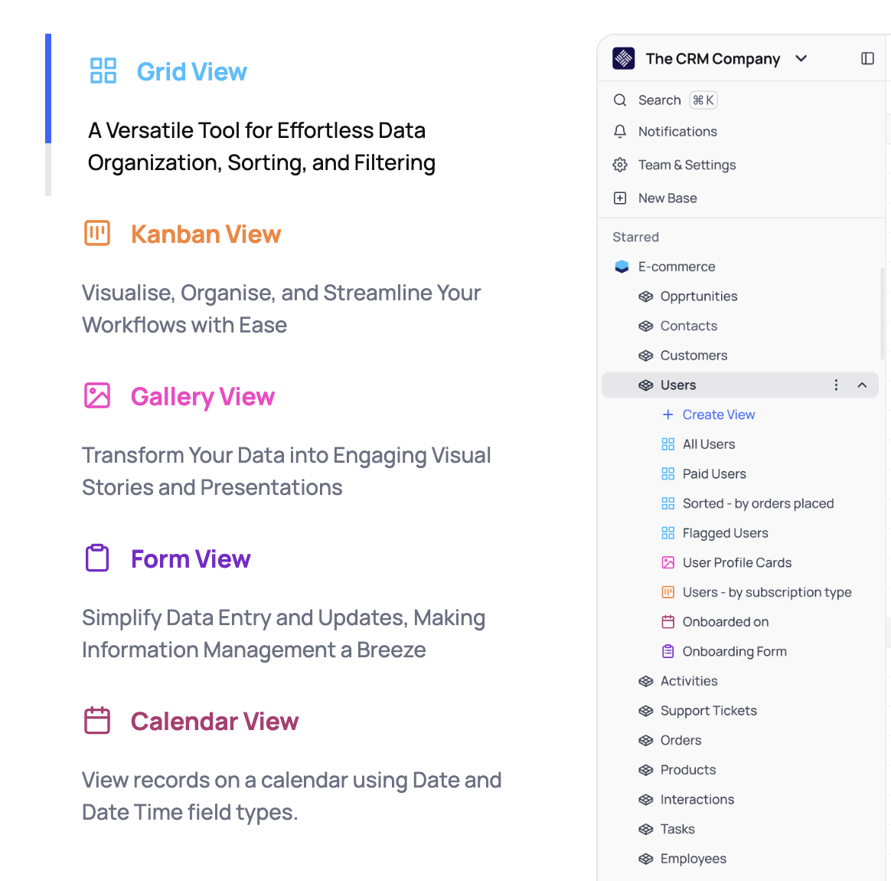
Customizable Views

Slide 8
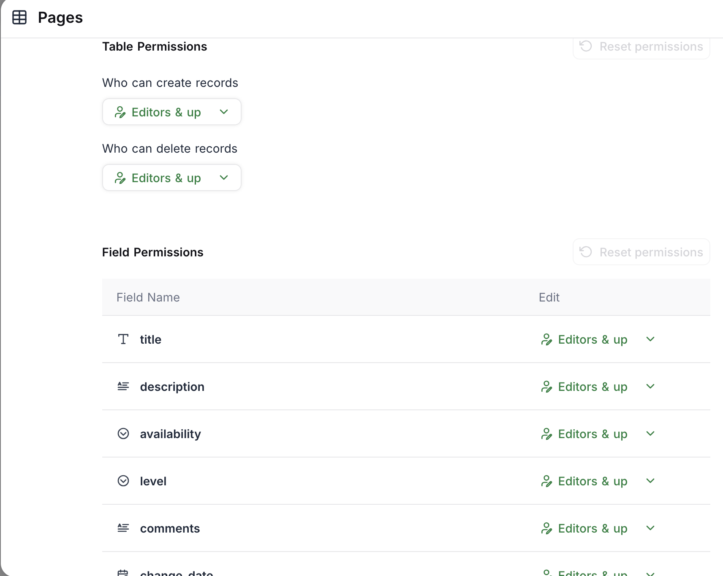
Role-Based Data Access Permissions

Slide 9
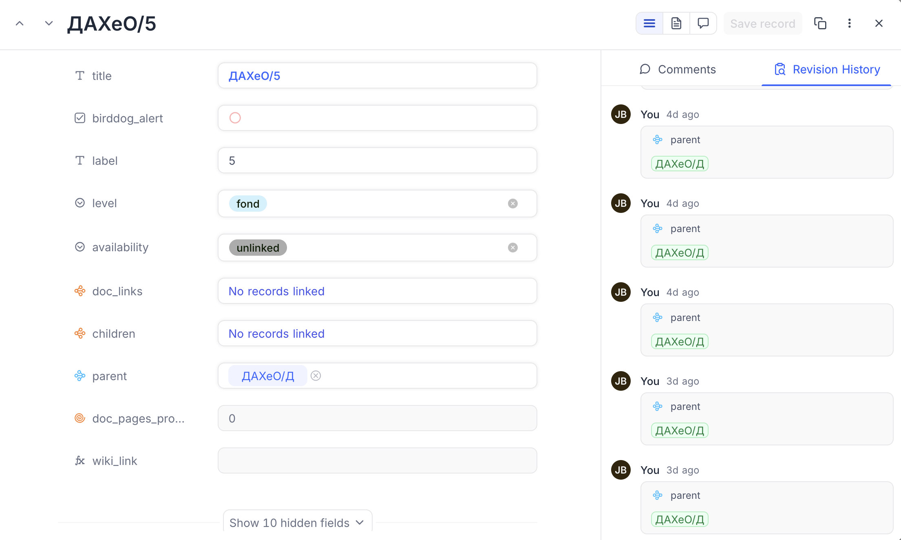
Revision History for All Data Changes

Slide 10
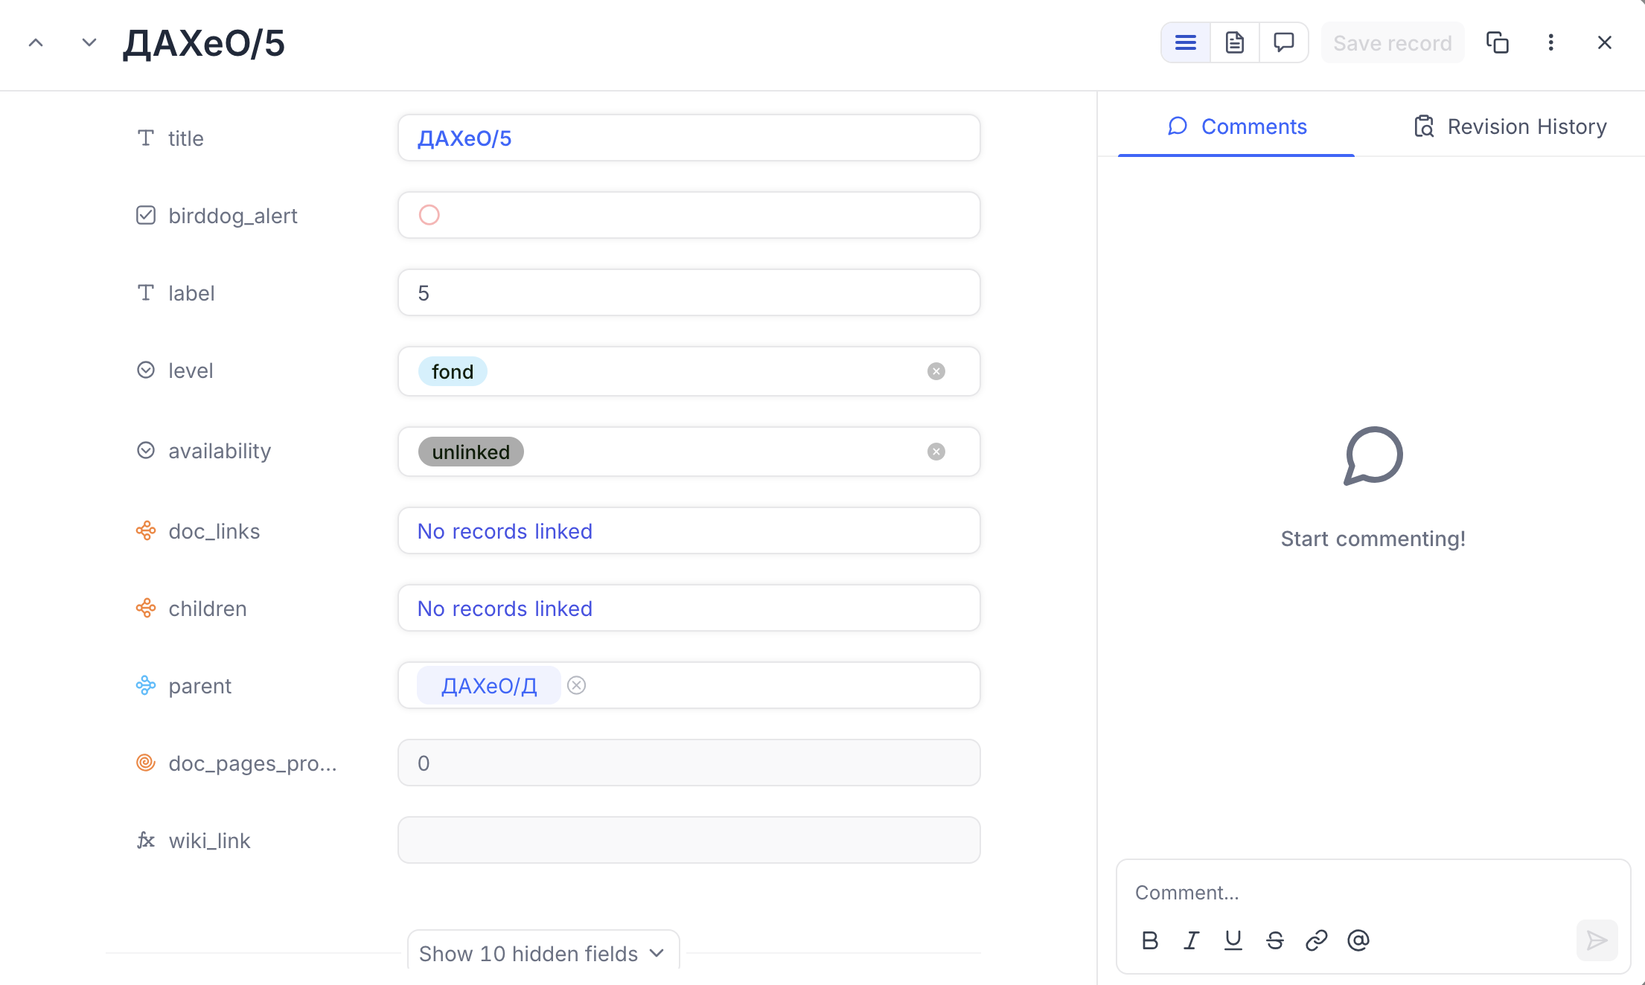
Per-Record Commenting

Slide 11
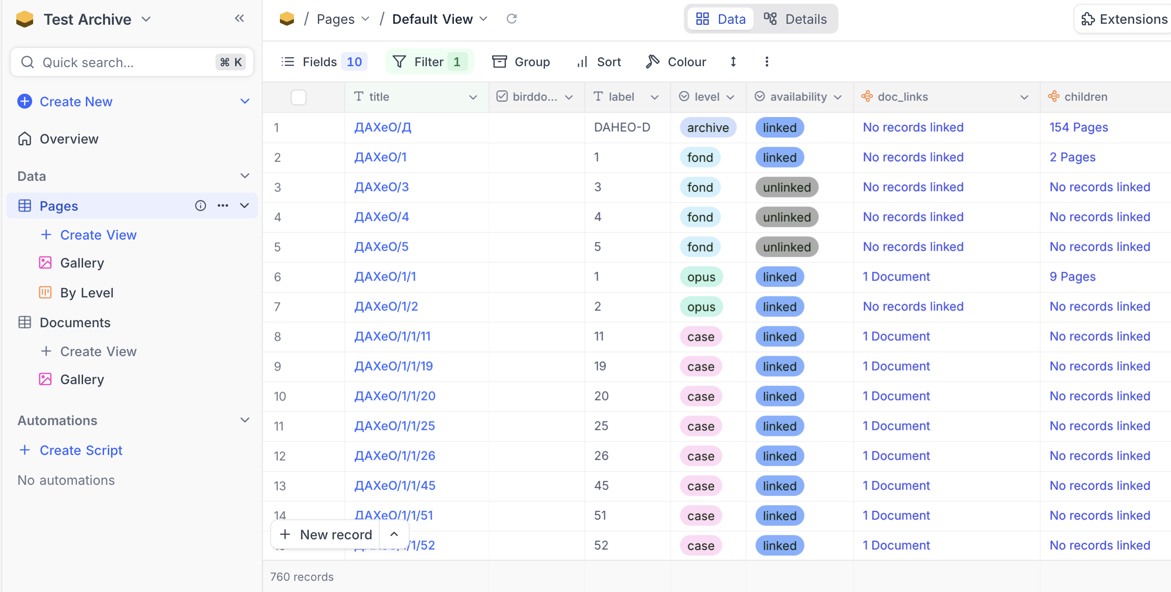
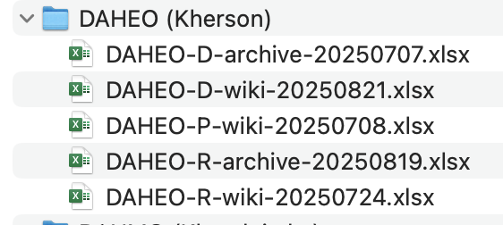
Initial Experiment with DAHEO

Slide 12
Database Schema:
Separate Page data from Scanned Document data
Page
a Wiki page
Title
Level (archive, fund, opus, case)
Availability (linked, unlinked)
Parent (page)
Children (pages)
Documents
Document
An attached scanned document
Document link
Document type
Content code
Process code
Processor
Pages processed
Owning page

Slide 13
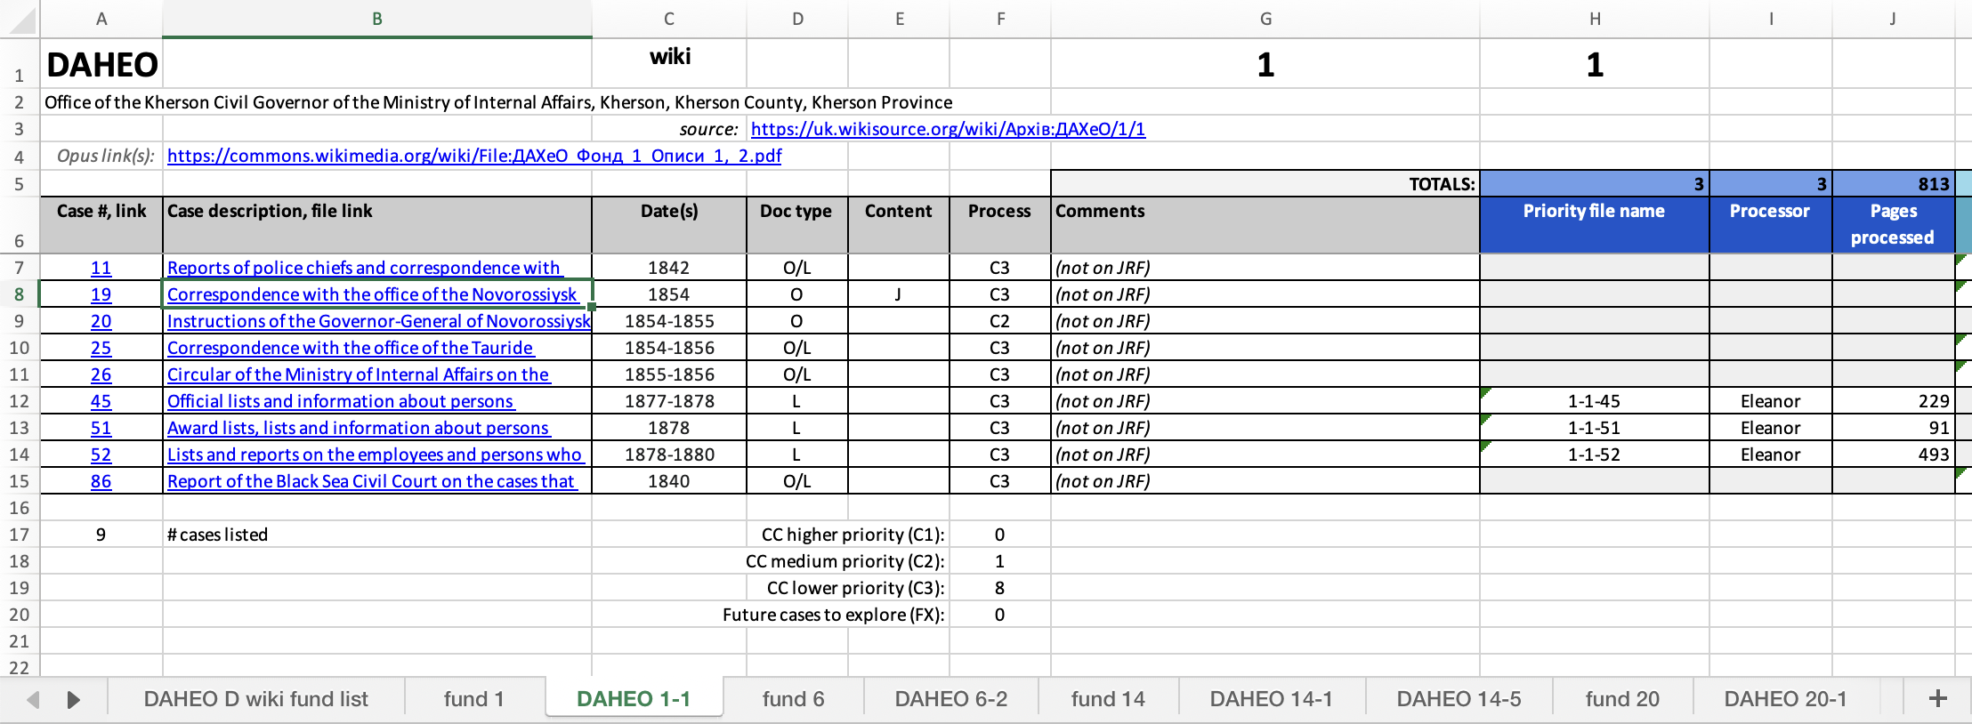
Page Data
Document Data

Slide 14
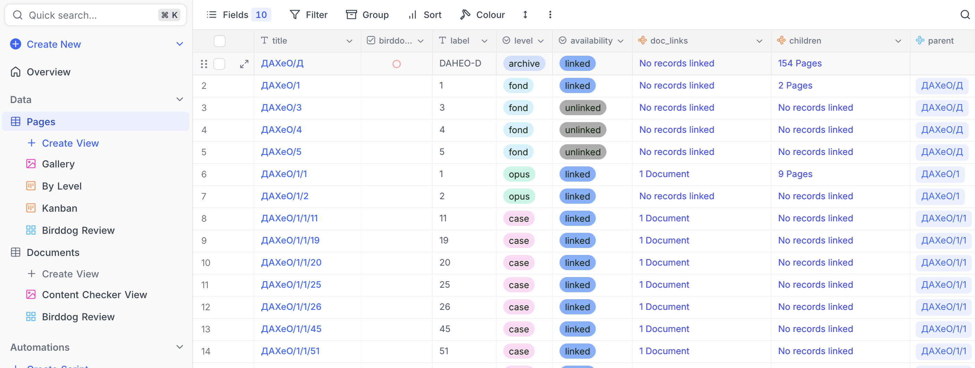
Pages Table

Slide 15
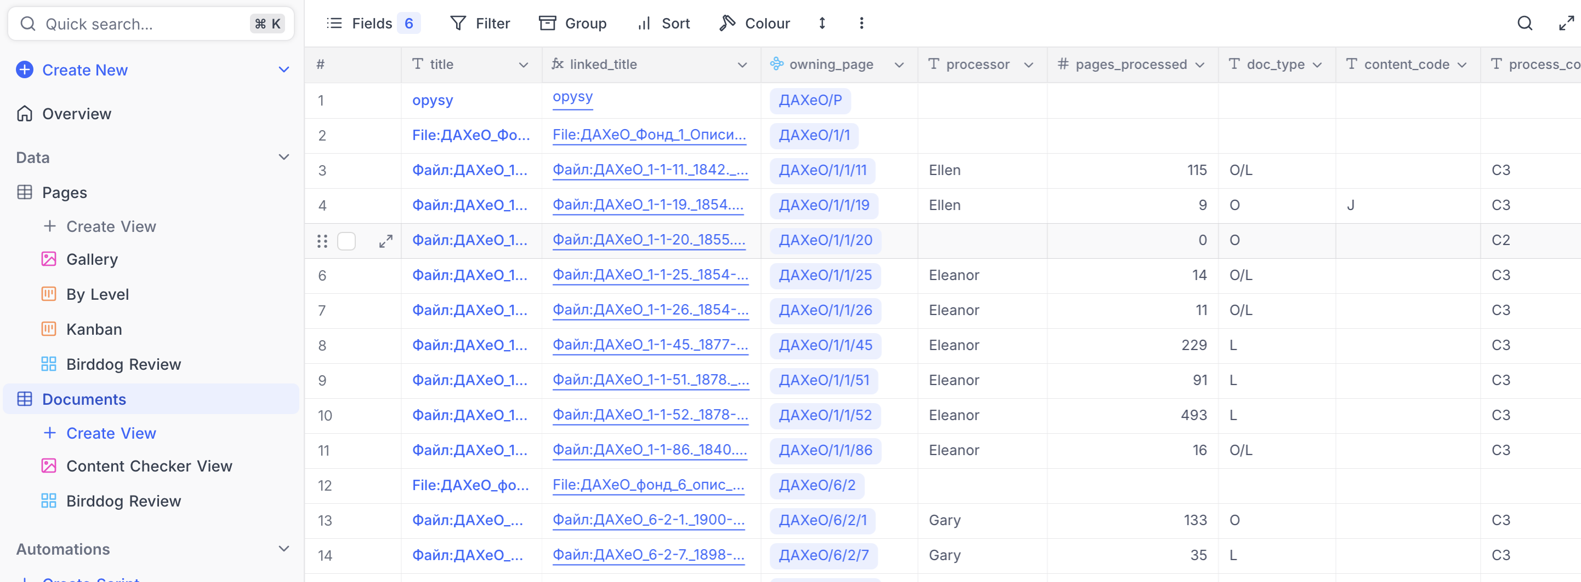
Documents Table

Slide 16
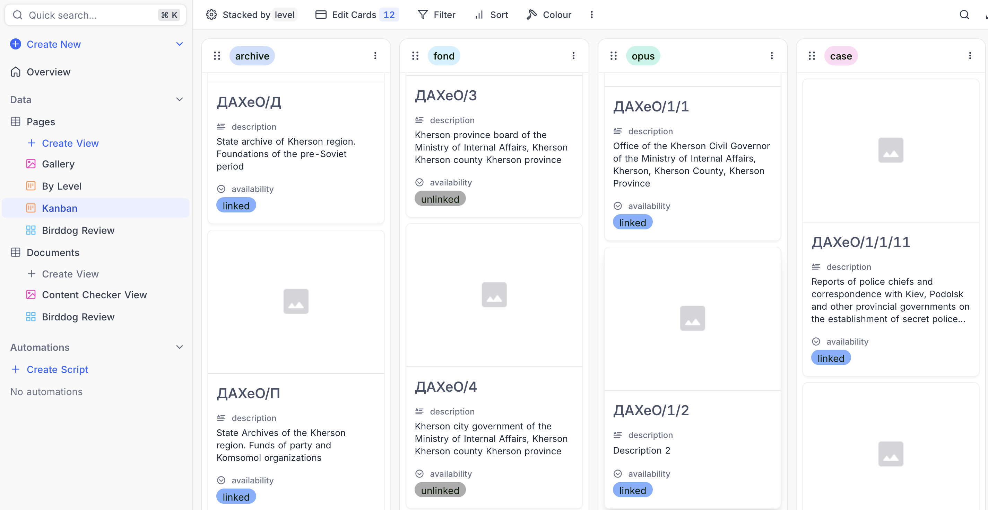
'Kanban” View of Pages table

Slide 17
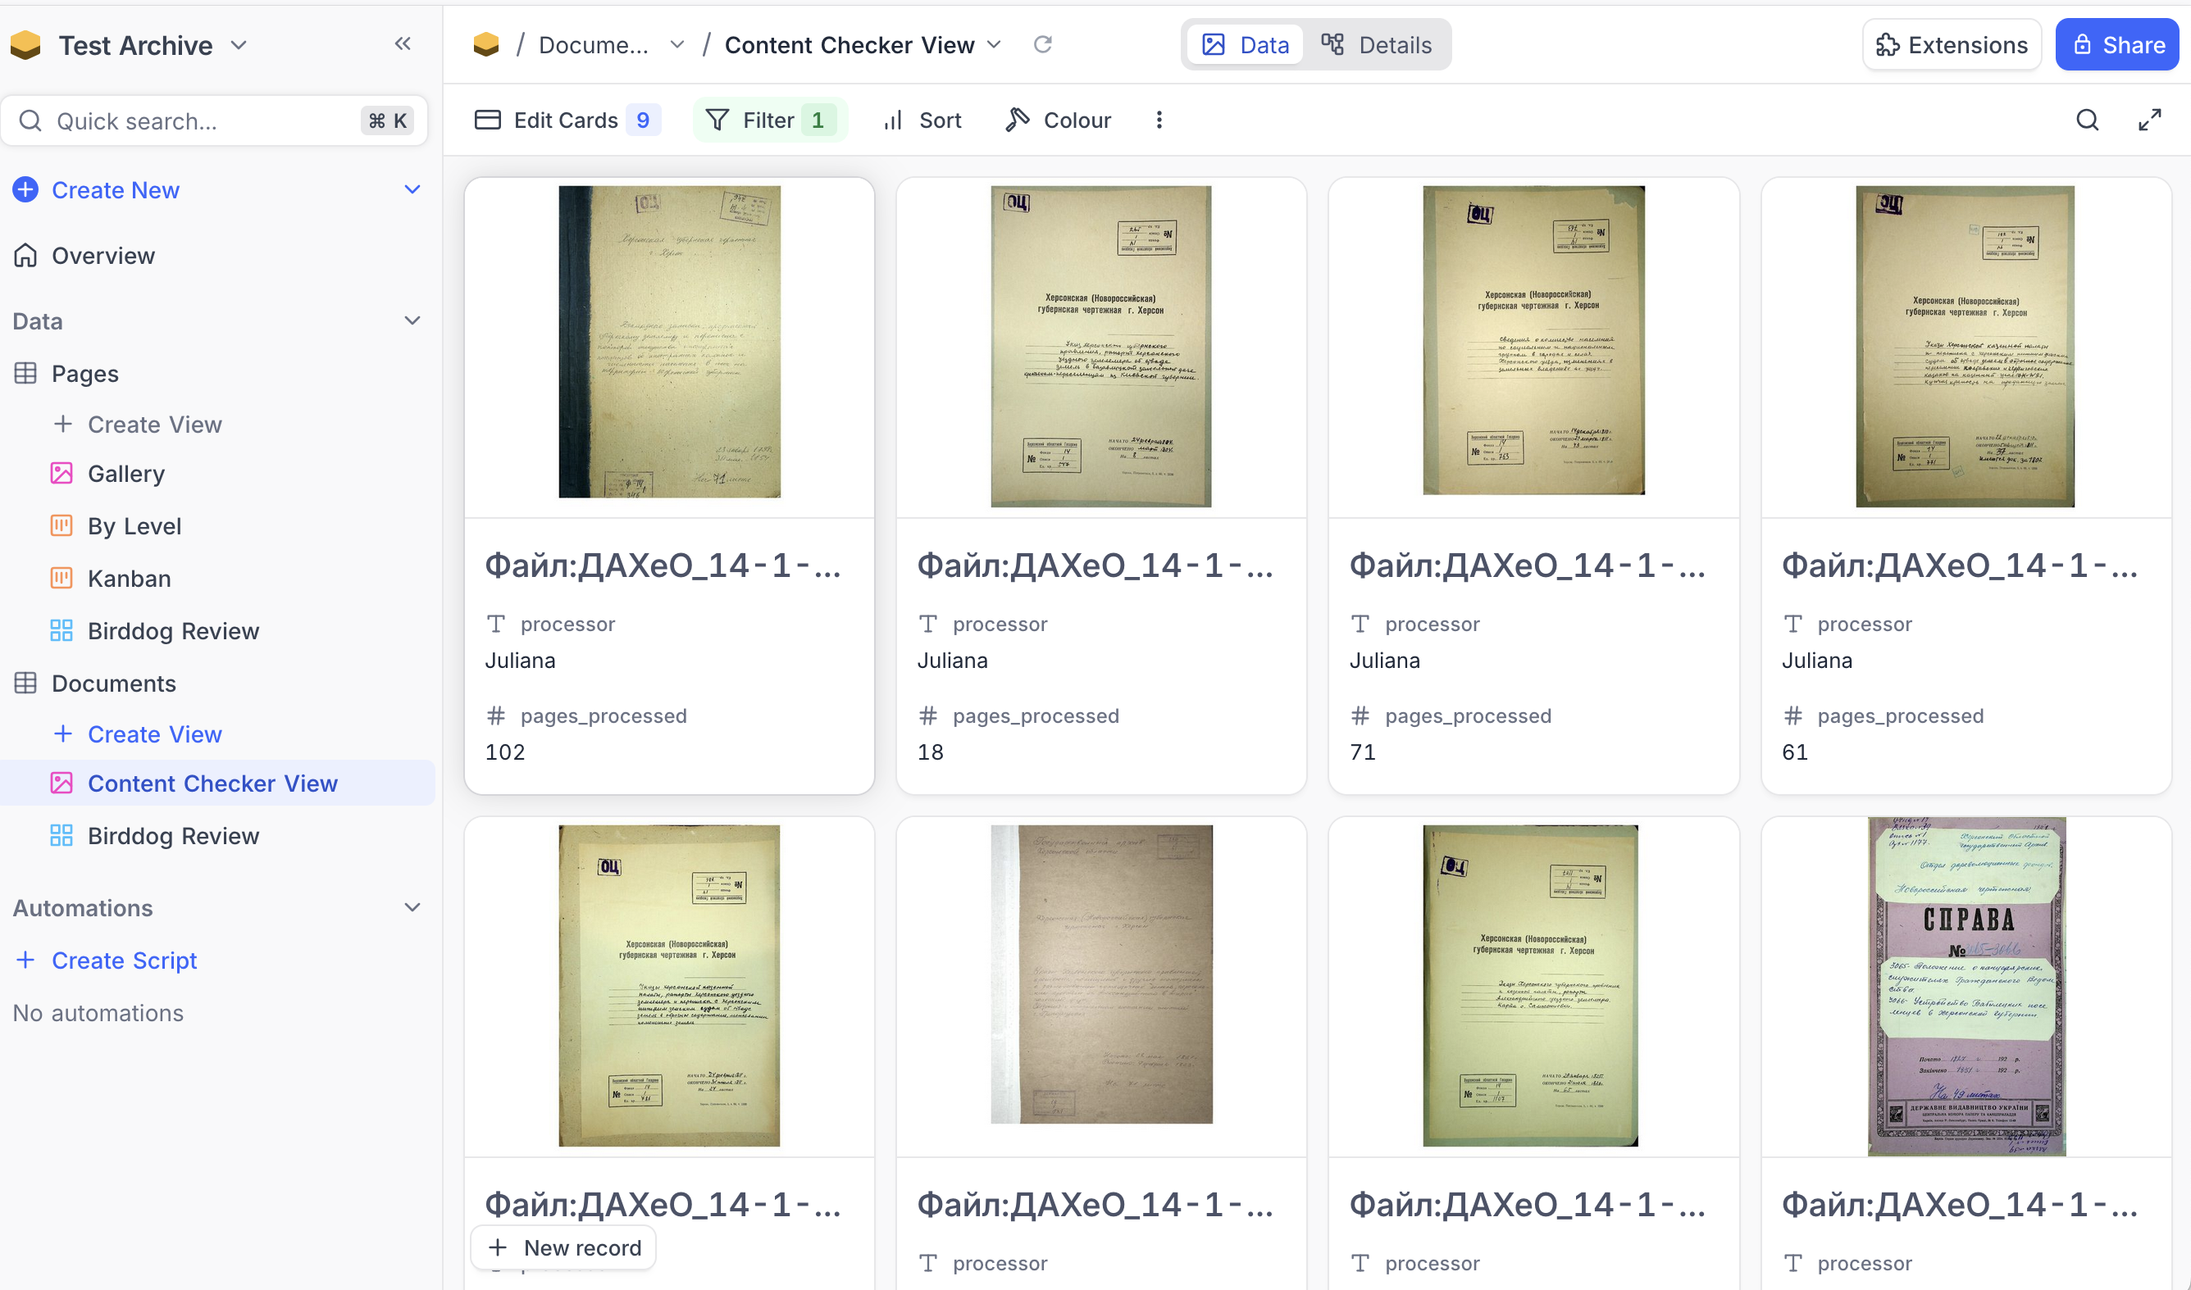
Gallery View for Content Checkers

Slide 18
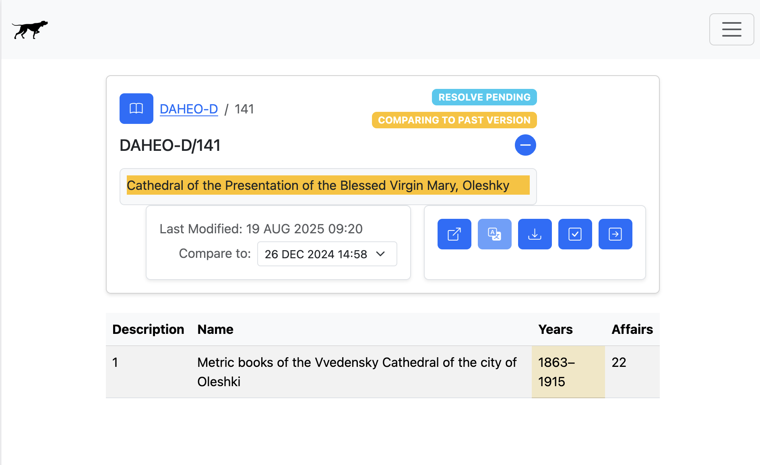
Birddog Integration (NOT YET!)
“Update database”

Slide 19
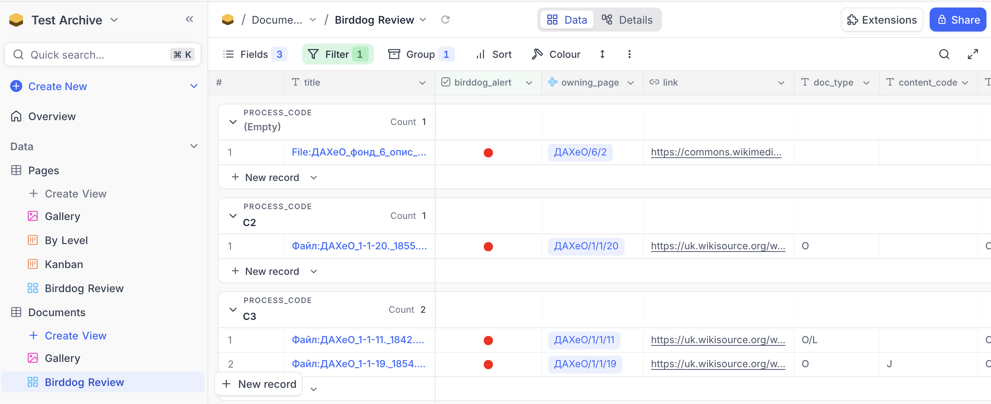
Mock-Up View for Reviewing Birddog Updates

Slide 20

Transition Process
Existing Google docs spreadsheet content is imported into the database to start.
Google docs continues to be used during the transition period.
Individual archive tracking is sequentially cut over to the database when ready.
Birddog is integrated to insert database updates based on ongoing Wiki archive changes.

Slide 21
Next Steps
More complete roll-ups (e.g. pages processed)
Birddog integration
Flesh out roles and views

